Slide 1
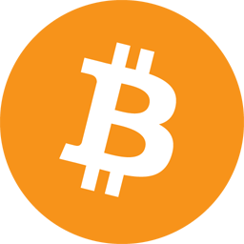
Bitcoin: A Practical Guide
Notes:
It has been said that Bitcoin is financial freedom disguised as a get-rich-quick scheme. While
I think Bitcoin’s technical capabilities are the most interesting, the quote still rings true. It’s only when you understand the current system and Bitcoin that you can appreciate what an amazing invention it is. Today I hope to transfer some of that understanding to you.

Slide 2
Bitcoin: A Practical Guide
Why Use Bitcoin
What is Bitcoin
How to Use Bitcoin
Notes:
I will briefly go over Why you should use Bitcoin, What Bitcoin Is, and How to use Bitcoin. Write down any questions you have and there will be a Q&A at the end where I can address them.

Slide 3
Bitcoin: A Practical Guide
Why Use Bitcoin?
Notes:
If you’ve never been dissatisfied with the current state of banks, you might not think Bitcoin is that useful. Hopefully, I can explain the current system and how Bitcoin radically improves upon it. Bitcoin is a way to store and send money, so we’ll compare those two methods between Bitcoin, the legacy banking system, and VISA.

Slide 4
Bitcoin: A Practical Guide
Legacy money (cash)
stored in bank
controlled by bank
VISA
can’t “store” money, only create debt
hybrid “debit” cards to pull from bank acct
Notes:
Storing Money
With the legacy banking system, your money is “stored” in a bank. This is partly inaccurate because often the bank doesn’t “store” your cash where you can get to it—they move it away and only deal with the money electronically. If you wanted to withdraw all of your money as cash, they may not even allow it. In other words, you loan your money to the bank with the promise that when you go to use it, they’ll allow you. Further, your money can be stolen, even legally if you’re suspected of a crime by being “frozen”. This is built into the system. Oh, and the banks are only open 9-5.
With VISA, you don’t store money, you create debt. VISA pays merchants for you, and you must pay VISA back. You can have a hybrid card called a debit card that is VISA compatible that pulls from your banking account, but again your money is not really your money.

Slide 5
Bitcoin: A Practical Guide
Bitcoin:
ledger stored “everywhere”
ledger can’t be changed
only you can spend your money
Notes:
With Bitcoin, your money is “stored” in a ledger with thousands of copies that can’t be changed. Anyone can check one of these copies for your balance, if they know which addresses are yours. Even though your balance is stored in multiple places, no one else can spend your money. The math backing Bitcoin won’t allow it, it’s like trying to find a way to make 2+2=5.

Slide 6
Bitcoin: A Practical Guide
Legacy money (cash)
Account number + Routing number
Send and receive with these numbers
Money actually moves after 1-3 days
Transactions reversible (for 9+ months)
VISA
16 digit number
Everything is a “pull”
Money actually moves after 24 hours or more
Transactions reversible (for weeks)
Notes:
Sending Money
With the legacy banking system, in order to send money you need a bank routing number and an account number. With these numbers, you can send and receive to/from the account, but it’s assumed if you pull money that you’re not supposed to, they’ll undo the transaction (if it’s noticed, which requires people to monitor your accounts). Transactions usually take about 1-3 days to settle, and transactions are reversible for a long time.
With VISA, all sends are actually pulls from your account, which is identified by a 16 digit number, and optionally an expiration date and CID code. If someone has this information, they can pull from your account. It’s only if VISA finds it suspicious or you dispute the transaction that they’ll reverse it. Transactions take at least a day to settle and transactions here are also reversible. The reason you probably didn’t know that transactions take so long to settle is VISA pays the merchant, not you. The merchants accept a temporary IOU from VISA until they actually get paid.

Slide 7
Bitcoin: A Practical Guide
Bitcoin:
Everything is a “push”
You pick who to send to, and how much
Only you control your funds
Transactions are irreversible (feature, not bug)
Transactions confirm in about 10 minutes
Notes:
With Bitcoin, you send money by sending your Bitcoin to someone else’s address. It’s a push, not a pull. You are in total control of how much and where the money goes, and no one can stop you from sending the money. This means no one can “freeze” your account by preventing you from making a transaction, since as long as your transaction is valid, all it takes is one honest miner to confirm it for you, and it’s permanent. This is a feature, not a bug – you don’t want someone telling you that you didn’t pay the day after you paid them.

Slide 8
Bitcoin: A Practical Guide
What is Bitcoin?
Notes:
Since things sometimes get technical, I will explain what Bitcoin is 3 times. First, I’ll explain it as simply as I can, like you’re five. Then, I’ll explain it with some more technical concepts most people should understand, like you’re a 15 year old. Then I’ll explain it faithfully, using terms some people might not understand. This explanation is for the nerds among you. All of the explanations are accurate, it’s just that some of them will gloss over some things. Don’t get discouraged if you don’t understand, and there will be time at the end to ask any question you want.

Slide 9
Bitcoin: A Practical Guide
Bitcoin is Internet money.
Bitcoin is made by special computers that solve hard math problems.
Anyone can use Bitcoin as long as they have a computer or a smartphone.
Bitcoin is stored in "wallets" which are just apps that store, send, and receive Bitcoin. You can send Bitcoin to anyone in the world.
Bitcoin's price is determined by how many Bitcoin that are for sale
and how much people are willing to pay for some Bitcoin.
Notes:
This is Bitcoin explained like you’re five:
Bitcoin is internet money. Bitcoin is made by special computers that solve hard math problems. Anyone can use Bitcoin as long as they have a computer or a smartphone. Bitcoin is stored in "wallets" which are just apps that store, send, and receive Bitcoin. You can send Bitcoin to anyone in the world. Bitcoin's price is determined by how many Bitcoin that are for sale, and how much people are willing to pay for some Bitcoin.

Slide 10
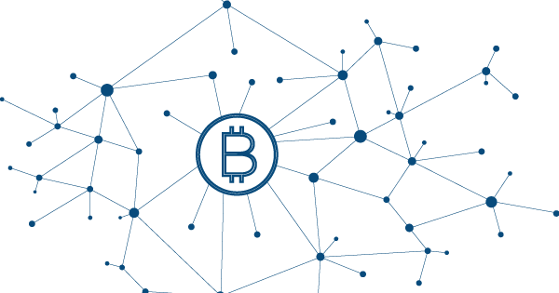
Bitcoin: A Practical Guide
The Currency
(Bitcoin or BTC)
The Network
Notes:
This is Bitcoin explained like you’re fifteen:
Bitcoin usually refers to both the store of value or currency, a Bitcoin (which is like digital gold), and the network on which to spend it, the Bitcoin network (which is like the VISA payment network). Bitcoin is "mined" by special purpose computers, and by mining Bitcoin, they help make the network secure. Anyone can use Bitcoin, as long as they have a computer or a smartphone. Bitcoin is stored in "wallets", which is usually a smartphone app, but it can also be a physical device called a “Hardware Wallet”. In order to send Bitcoin, you need to have Bitcoin to send. There are a few ways to get Bitcoin:

Slide 11
Bitcoin: A Practical Guide
Exchange
Trade with someone you know
Sell goods for Bitcoin
Sell services for Bitcoin
Use expensive, specialized equipment and mine Bitcoin
Ways to get Bitcoin
Notes:
Go to an exchange and give them your local currency (dollars, euros, won, yen, rubles), they will then send you Bitcoin
Find someone locally that is willing to trade some currency for Bitcoin
Sell goods or provide a service for Bitcoin
Be a miner who has invested millions of dollars into mining and find a block.

Slide 12
Bitcoin: A Practical Guide
Deflationary (as opposed to inflationary like dollars)
There will only ever be, at most, 21 million Bitcoin
One Bitcoin is divisible into 100 million pieces
Notes:
Bitcoin uses technology similar to the technology you use to browse the Web to make sure it's secure. Bitcoin's price is based on supply and demand, but Bitcoin is unique in that it's a deflationary currency. There will never be more than 21 million Bitcoin, and right now, only 17 million have been mined. Bitcoin transactions, once confirmed, are permanent, so users must be careful to send the right amounts to the right addresses. One Bitcoin is divisible into 100 million parts, so many people own and use less than one Bitcoin.

Slide 13

Bitcoin: A Practical Guide
Bitcoin has a blockchain
Blockchain is just ordered data that each update references the previous update.
Notes:
And here is Bitcoin explained as simply and accurately as possible:
Bitcoin was the first mainstream cryptocurrency, which means "a digitally secure store of value". Bitcoin introduced the concept of the Blockchain, which is like a public checkbook that includes a permanent record of everyone's transactions. A blockchain is just ordered data where each update references the previous update so the order can’t easily be changed. Bitcoin is also peer-to-peer (like BitTorrent or the Internet itself), so anyone can use the network and you don't need a central server. It runs on its own, and even if half the network went down it would continue working without a hitch.

Slide 14
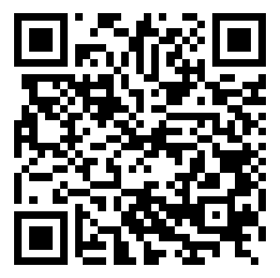
Bitcoin: A Practical Guide
Bitcoin Addresses
13L7ffKU1ZbXqyUsunvV29PziVNKdtDAJY
37C5jBc5rSFGaFAyziSYq4VWPAPeVC4imQ
bc1qujrzl6zafqr7vkaml09fct5gmkz88tf3jd042y
Notes:
Bitcoin is stored in "wallets", and is sent to "Bitcoin addresses". Bitcoin uses Public Key Cryptography (just like the Web does) to secure itself. You send Bitcoin to someone else’s Bitcoin address (which is technically a public key). They can then spend it by signing a transaction with the private key that corresponds to that public key/address. Only signed transactions that match up with the public key and are valid. These are what Bitcoin addresses look like. Addresses are sometimes rendered as QR codes for easy scanning by smartphones.

Slide 15

Bitcoin: A Practical Guide
Bitcoin uses Public Key Cryptography
Same technology used on the web
2 keys: Public and Private
Private key sends funds
Public key/address receives funds
Notes:
With a signed transaction and the public key, both of which are very public on Bitcoin, anyone can verify that the transaction is valid and was signed with the private key, which was never revealed. In order for a transaction to be included on the blockchain, it has to be valid which means:
It was sent from an address with a balance (you can’t spend more than you have)
It is properly signed (you can’t spend money that’s not yours)
Miners included it into a block. (you need to pay the miner’s fee)
Miners decide to include a transaction in a block based on how big of a transaction fee you include. If you include a fee much higher than what everyone else is paying, miners have an incentive to prioritize your transaction. If you include a low fee, miners might prioritize higher fee transactions over yours.

Slide 16
Bitcoin: A Practical Guide
Block time: 10 minutes
Miners look for the winning hash
Current block reward: 12.5 BTC
Miners keep transaction fees and block reward
Example block hash: 00000000000000000008f720407416ee62c051e2dab8bc5b170343653e8479b9
From block 489583
Notes:
Bitcoin's public ledger (sort of like a public checkbook) is called the blockchain. It's called the blockchain because about every 10 minutes, a new "block" should be found by Bitcoin miners, and added to the end of the chain of blocks. Miners get to “create” Bitcoin by claiming the block reward, which is currently 12.5 Bitcoin. This reward halves every once in a while in a predictable way. The miners (which are usually thousands of expensive machines located near cheap sources of power and internet) are basically simple computers that perform a certain type of operation billions or trillions of times per second called "hashing".

Slide 17
Bitcoin: A Practical Guide
Hashing – same data, same output
Used to make sure files are transferred over the Internet without errors
SHA256 hash for “Bitcoin rules” is a7d3f796c214305f986c1e35e1ca8f7c867b92f1e9d4190bc4809c24a67abe9d
Notes:
When you "hash" data, it comes out completely changed, but in a repeatable way (if both you and your friend hash the same data, you should get the same output). This is mostly used in the computer world to make sure files didn't get corrupted when being transferred on the internet, since if you run your copy of a file through a hashing function and compare it to your friend's output, if it's the same you know that the files are identical. Bitcoin miners take part of the previous block and try to find some data to add to it so the hash ends up looking special (see slide). Everyone who participates in Bitcoin agrees, if you find a unique enough hash, you get to make a new block to add to the chain. Since the hash includes data from the last block, once you find a new block everyone starts the whole process over again. When miners find a block, they get to claim a "block reward" (which is 12.5 BTC right now), plus they get to keep all of the "transaction fees" of each transaction they include in a block.

Slide 18

Bitcoin: A Practical Guide
Bitcoin’s price: Supply and Demand
Like digital gold
Can own fractions of a Bitcoin
0.00000001 is smallest unit
Notes:
Bitcoin's price fluctuates because supply and demand fluctuate. Bitcoin's often compared to gold because there's a finite amount of it. If I own 1 out of 21 million Bitcoin, that means at most you could own 20,999,999 Bitcoin, assuming everyone else wanted to sell you theirs. But the truth is most people with Bitcoin want to "HODL" (hold) their Bitcoin, and only spend it as rarely as possible, since there will only ever be but so many. Since a lot of people don't want to sell, the price goes up. It keeps on going up because more and more Bitcoin keep getting bought by people who won't want to sell it for dollars. It’s also important to note you can own fractions of a Bitcoin. Bitcoin still works great when you’re transferring 0.0001 of it.

Slide 19
Bitcoin: A Practical Guide
The most important part about Bitcoin, the thing that's most revolutionary is that with Bitcoin, you don't have to trust anyone to send money. If you want to send money by the banking system today, all you need is an account number and a routing number and you can wire money in or out, but you need to trust the banks to do so. An account with a bank is also just an IOU from the bank for your money, whereas with Bitcoin you own your money. You don't need a bank to send it, and no one but you can spend it.
The exciting part:
YOU OWN YOUR MONEY
Notes:
The most important part about Bitcoin, the thing that's most revolutionary is that with Bitcoin, you don't have to trust anyone to send money. If you want to send money by the banking system today, all you need is an account number and a routing number and you can wire money in or out, but you need to trust the banks to do so. An account with a bank is also just an IOU from the bank for own your money, whereas with Bitcoin you own your money. You don't need a bank to send it, and no one but you can spend it.

Slide 20
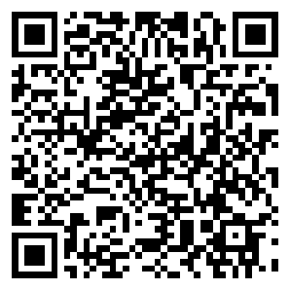
Bitcoin: A Practical Guide
Bitcoin Wallets
Need to be able to see the code for yourself
Controls your Bitcoin for you
https://play.google.com/store/apps/details?id=de.schildbach.wallet
Notes:
How to Use Bitcoin
To use Bitcoin, all you need is a Bitcoin Wallet. There are a lot of them out there, and you must be careful to use one that’s open-source, as that means that people can inspect it to make sure that it doesn’t steal your Bitcoin. There’s a lot of money to be had in stealing Bitcoin, so I recommend if you’re first starting out to use this Android wallet: https://play.google.com/store/apps/details?id=de.schildbach.wallet. I’ve added a QR code to the slides in case you wanted to scan it.

Slide 21
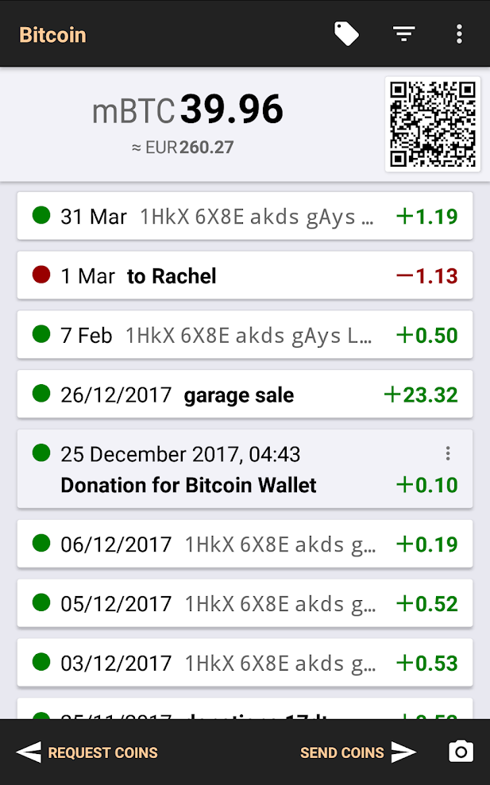
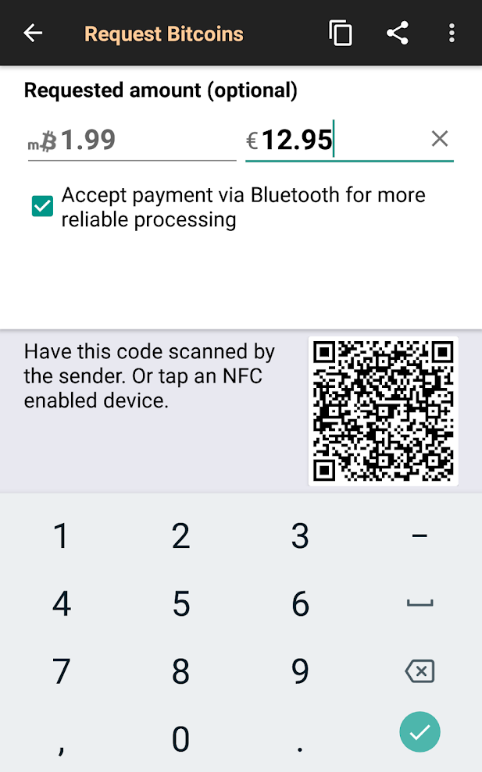
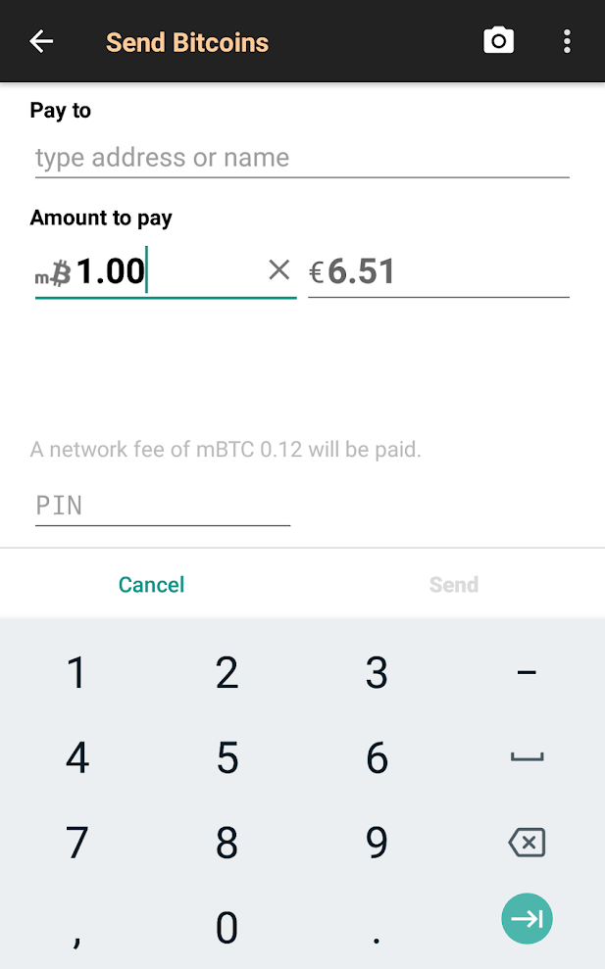
Bitcoin: A Practical Guide
Notes:
After opening the wallet you’ll see a screen with your balance (0), a QR code, and the options to “Request coins”, “Send coins”, and a camera icon. Here’s what these options do:
“Request coins”: This opens a new screen that asks for amounts, in Bitcoin or your local currency. You can enter the amount and then have someone else scan the QR code on their phone to get your address and the amount. You can also hit the “Copy to Clipboard” icon in the top right, or the Share icon if you need to message someone who’s not in the same area as you.
“Send coins”: This opens a screen where you can paste a Bitcoin address and send any amount of Bitcoin. You can also press the camera icon in the top right to scan someone else’s QR code.
“QR code”: This is a picture that apps can scan to get data. The QR code on the main screen is another way to quickly receive Bitcoin – just press it and it will display an address that others can scan to send you Bitcoin.
A Spending PIN can optionally be enabled in the Safety menu to be required to be entered when sending money.
That’s the basics of usage. To receive your first Bitcoin, press “Request Coins” and give the sender your Bitcoin address. Now lets go through an example scenario.

Slide 22
Friend Selling T-Shirt:
Press QR Code on main screen
Let you scan it
You, buying his T-Shirt
Press camera icon in bottom right
Scan his QR code
Enter amount
(optional) pick transaction fee
Hit send
Then both of you wait 10-20 minutes for confirmation
Notes:
Buying something from a friend
Lets say your friend is selling you his custom T-Shirt. You ask him for his address, and he displays his QR code for you to scan. You open your Bitcoin Wallet, press “Send Coins”→Camera (Or just the camera icon on the main screen) and scan his QR code. His address will fill into the Pay to field, and you can enter $5 under “Amount to pay” and then hit Send.

Slide 23
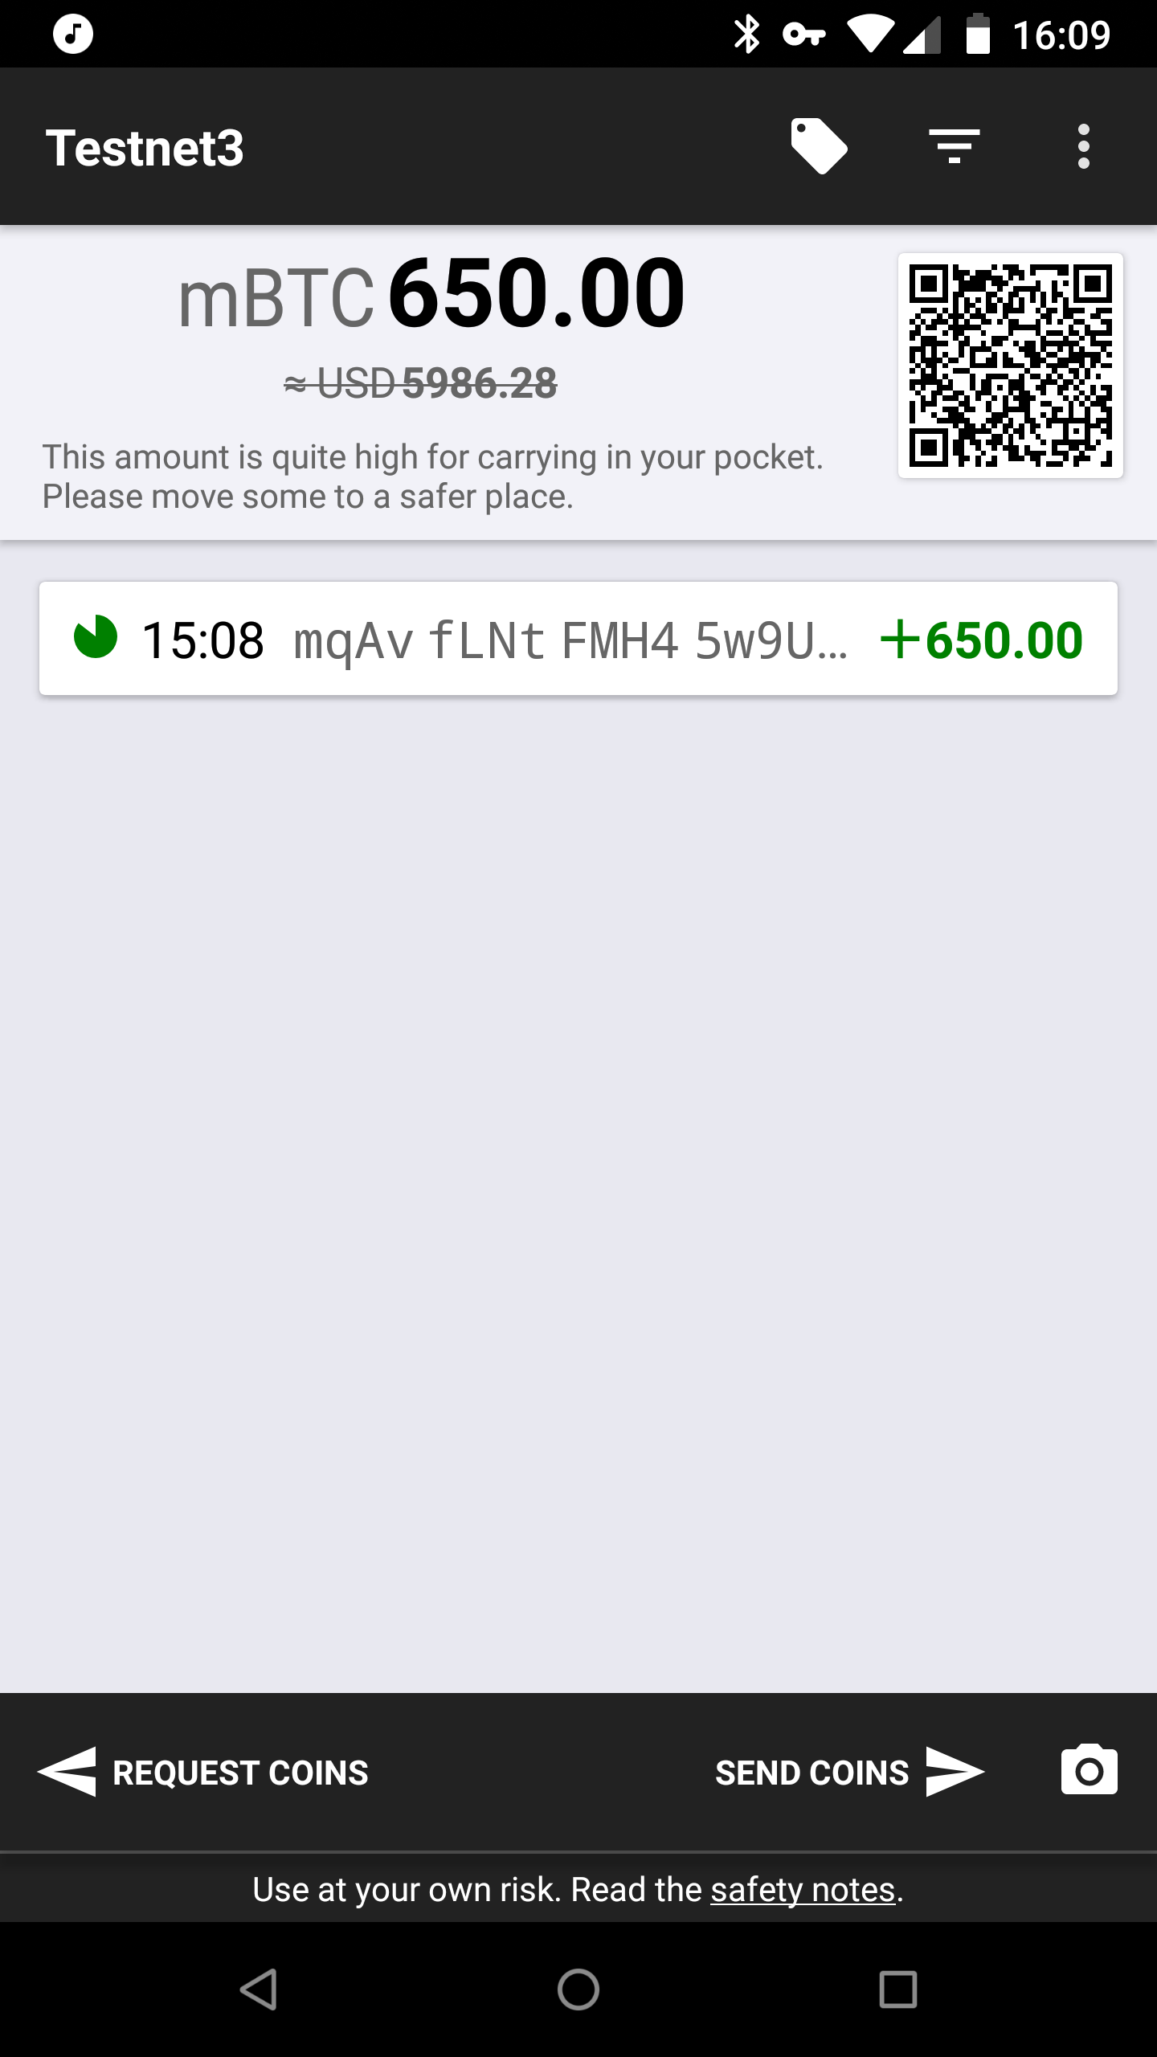
Bitcoin: A Practical Guide
Notes:
Confirmations
Bitcoin transactions are instantly sent, but require confirmations in order to be secure. For the very largest transactions (millions of dollars worth of Bitcoin) you should wait 6 confirmations in order to be sure the transaction is permanent. For small payments, just one confirmation will do as reversing a confirmation is possible but very difficult to do, and only by the biggest of miners.

Slide 24
Bitcoin: A Practical Guide
BACK UP YOUR BITCOIN!!!
Notes:
Backing up your Bitcoin
Your Bitcoin is secured by a key that’s stored in your app, but if something happens to your phone, you could lose access. That’s why you should back up your Bitcoin wallet periodically. To back it up, hit the 3 dots in the main screen, then go to Safety→Back up wallet. Type in a secure but memorable password, and hit OK. Then pick a place to save the backup on your phone.
From another app, save your wallet backup somewhere else such as Dropbox or OwnCloud.

Slide 25
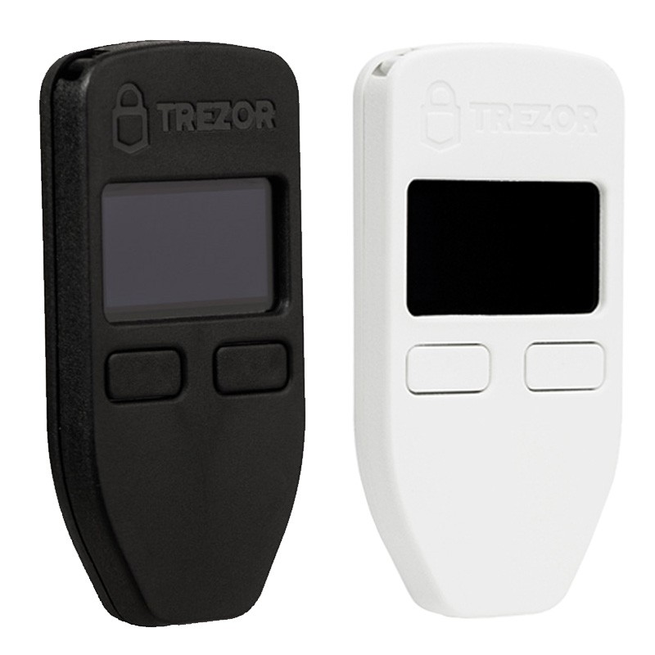
Bitcoin: A Practical Guide
minor when isolate
fuel skill eager
surge supreme wage
salute harvest salad
Notes:
Mnemonic seeds
Bitcoin can also optionally be secured with a mnemonic seed, like the one shown. This is a convenient way to secure your Bitcoin against data loss as all you need is a pen and paper to secure your Bitcoin. Unfortunately, the wallet I recommend doesn’t support saving or importing a mnemonic phrase, but secure devices like Trezor do. These are an even better way to secure your Bitcoin because the private key stays on the device, which is single purpose. If your cellphone gets hacked, your Bitcoin could be at risk. Trezors are simpler than a cell phone, so there is less of a chance of them getting hacked. Also, they’re usually not connected to anything, which makes them much more secure.

Slide 26
Bitcoin: A Practical Guide
Q&A
Notes:
Now, what questions do you have?

Slide 27
Bitcoin: A Practical Guide
Thank You
Notes:
Thank You

